Slide 1
rent a photo booth Culver City
https://www.luckyfrogphotos.com/culvercityphotobooth.html
Notes:
https://www.luckyfrogphotos.com/culvercityphotobooth.html
https://drive.google.com/drive/folders/1loXgXNoE0I-RUbZWpLffER06fJ9YMdyE?usp=sharing
https://news.google.com/rss/search?q=videobooth
https://drive.google.com/drive/folders/1qc6tVCQqRXXF0EGfi8RbKLRrO9F6ABHu?usp=sharing
https://drive.google.com/drive/folders/1N1PP73u5W5tC4VkDr9BUmz7gKxZ71_ZR?usp=sharing
https://drive.google.com/drive/folders/19MTUo0W0-2lUwI0l-_y66wtg8IQAaqWd?usp=sharing
https://drive.google.com/drive/folders/1-FVBDkwPBknBavqmSoiC3962KZAOGOSG?usp=sharing
https://drive.google.com/file/d/1t33hvFbsi4sSFSNdR8g74m5ACVKQUi0g/view?usp=sharing
https://drive.google.com/file/d/13FEqMU8tqfWCbQquqFn89zUfZ1CBVqm-/view?usp=sharing
https://docs.google.com/spreadsheets/d/1wPWac6UXW72WiHQ3msSOrrqfTVbcssrgwqAPwNmt1mI/edit?usp=sharing
https://docs.google.com/spreadsheet/pub?key=1wPWac6UXW72WiHQ3msSOrrqfTVbcssrgwqAPwNmt1mI
https://docs.google.com/spreadsheets/d/1wPWac6UXW72WiHQ3msSOrrqfTVbcssrgwqAPwNmt1mI/pubhtml
https://docs.google.com/spreadsheets/d/1wPWac6UXW72WiHQ3msSOrrqfTVbcssrgwqAPwNmt1mI/pub
https://docs.google.com/spreadsheets/d/1wPWac6UXW72WiHQ3msSOrrqfTVbcssrgwqAPwNmt1mI/view
https://docs.google.com/forms/d/1xWsZDmztQsiIMHcFyEw45F9FKfnyUCVNaUcltDlYG1k/edit?usp=sharing
https://docs.google.com/drawings/d/1286VxJkT-XuIYFKxB1ijMVUlOr5y7QmTDpwy-RdE4FI/edit?usp=sharing
https://drive.google.com/file/d/1Ub_baxN1yIKa7z6PHbWKiQ5Hv3QmkYdb/view?usp=drivesdk
https://sites.google.com/view/culvercityphotoboothrentals/home
https://docs.google.com/document/d/1uTUEX1mh-8qPhKwXAqI2PsSf_wg8Scfp2QdfALs1d68/edit?usp=sharing
https://docs.google.com/document/d/1uTUEX1mh-8qPhKwXAqI2PsSf_wg8Scfp2QdfALs1d68/pub
https://docs.google.com/document/d/1uTUEX1mh-8qPhKwXAqI2PsSf_wg8Scfp2QdfALs1d68/view
https://docs.google.com/presentation/d/17WPDLuvcmRucLX-WnsvOM8TXcs18dp0ev9ZtfqhFATo/edit?usp=sharing
https://docs.google.com/presentation/d/17WPDLuvcmRucLX-WnsvOM8TXcs18dp0ev9ZtfqhFATo/pub?start=true&loop=true&delayms=3000
https://docs.google.com/presentation/d/17WPDLuvcmRucLX-WnsvOM8TXcs18dp0ev9ZtfqhFATo/view
https://docs.google.com/presentation/d/17WPDLuvcmRucLX-WnsvOM8TXcs18dp0ev9ZtfqhFATo/htmlpresent

Slide 2
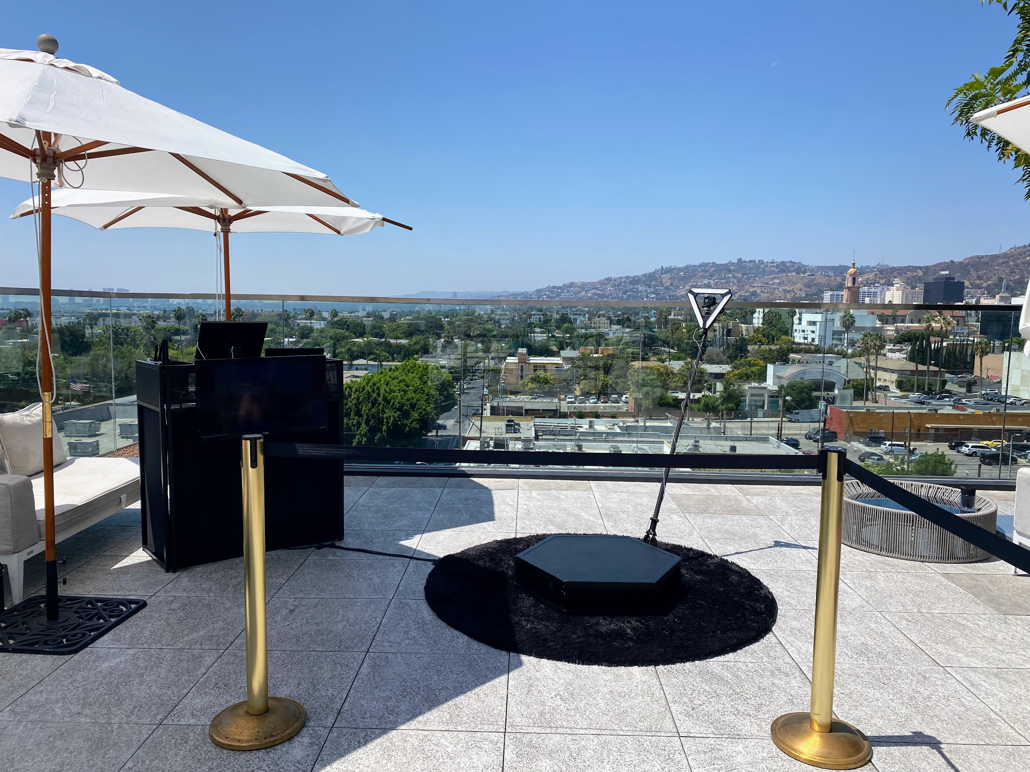

Slide 4
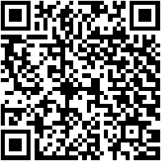
rent a photo booth Culver City
Just taking into consideration Dining out, not all 360 video booth rentals near San Gabriel are similar. considering our best setting photo booth services, we hand crafted the best setting spinner platform and slow endeavor video gear to create positive your slomo Videos are the best in al of San Gabriel and the 626 area. Our right of entry expose Photo Booths, Selfie Stations, Video booths and 360 Photo Booths are really one of a kind, and are crafted using single-handedly the best materials not far off from Los Angeles. Unlike the lower feel made in China booths that are a dime a dozen, our unique booths are handcrafted, professionally made and will look fabulous at your next-door thing on the subject of San Gabriel. Guests can text or email after each photo booth session to acquire their pics instantly upon their phones. Guests can as a consequence Text and Email the photos and boomerang GIFs at the booth using our simple to use Photo Booth software. We on your own use the best mood multimedia equipment that offers the best for deeds in Los Angeles and have the funds for High-end like social media integration and {} we are a photo entertainment company that specializes in studio lighting techniques. Our photo booth Pictures are the highest tone in Los Angeles and all of orangey County, are in focus and definite bearing in mind proper studio lighting. We in addition to find the money for the agreed best in unique or custom options to customize the print designs using your brand, logo and theme. We have a big selection of backdrops that are some of the finest available, and will offer a great and fun pretentiousness to make smile for any occasion Our 360 booths are a good ice breaker for guests here in the San Gabriel Valley, and we have a bunch of substitute looks to be in agreement your 626 event. Also, the customer assist experience we have the funds for guaranteed to make your corporate event, wedding or further occasion unforgettable, and to save the photo booth fun for you and your guests. Lastly, while creating lasting memories, we will create certain youll acquire lab-quality photos from the get into freshen photo booth. You have a huge number of possibilities for your adjacent photo booth rentals here in San Gabriel, and is a absolute fit for any matter type. Our Photo booths create a customized experience for any event,and Best Photo Booths Fun For all Ages and we honor Winning relieve that is unmatched. The character of the photo kiosk is super important; after all, you dont want an unprofessional-looking photo booth at your adjacent event! We dwell on to find the money for our customers a astounding photo experience and we are Southern California's premier special thing photo booth company, lucky Frog Photo Booth is the Los Angeles and yellowish-brown County area's premier photo booth rental company that is tailor-made for concentration and photo entertainment. Each matter has its lasting memories, and we will make determined everything gets custom tailored to your thing needs. Our 360 Photo Booth is very unique and handcrafted in the USA, and will increase upon a unique supplement to just more or less any event: We will be glad to mosey you through the booking process, we will go as far away as humanly attainable to create your situation happen.
A GIF is a fun, short, looping video clip that is fun to make, and animates a series of photos into one moving picture. GIF selfie kiosks both create use of boomerangs to create a video loop or take over a chain of pix in a burst to generate a GIF or boomerang video. {} {} Photo kiosks will allow more associations in the same way as your celebration visitors and make a sharable video that everybody can enjoy instantly. Slow-mo changes everything in the video, in view of that even a little leisure interest can look super cool. in imitation of many other technologies, a slo mo video was past reserved and no-one else for film studios, however it has now made its way to a photo booth rental. {} {} Relive captured matter videos together along following your contacts or pronounce the videos online for all your followers to enjoy.Choose the maximum adequate area on your video booth setup; usually in this area 15 ft x 15 ft works great. {} Your video booth setup needs to be located gone no obstructions in its area. Our 360 photo booth rental is more than just a suitable door expose photo booth; It will meet the expense of a unique video experience and permit you to take over your thing in a comprehensive additional way. {} Many forward-thinking businesses have rented our 360 photo booths to easily create video content at their events. {} {} {}&nbsp;Regardless of the business type, the 360 video booth gives a one-of-a-kind experience for any event; Thanksgiving Parties, Office get-togethers, Corporate Functions, relations Christmas parties, Company Parties, Holiday Events, Santa Celebrations, Hanukkah Parties just to reveal a few. {} Your plan should be to have enough money issue guests an experience they can easily allocation and renting a 360 photo booth assistance is one of the most fun ways for you to level happening any event. In the age of Tiktock and stories, video content is taking higher than social media, considering lots more assimilation coming from a video say vs photos. as soon as many tawny County issue planners these days, you may be wondering how to occupy a immediate video at your concern for attendees to allowance instantly. After show some research, you may have realized that hiring a professional video team is too costly and the production time takes weeks if not months to fabricate vibes video content. Using huge video lights, production equipment, and the production team that runs them can be utterly intimidating to the participants who are not used to living thing in tummy of a professional camera. Our Viral Video Photo Booth is the ideal solution for orangey County issue planners who compulsion to create fascinating user-generated videos for social media and develop them in real time. Social Media is every very nearly feint things fast, and lets perspective it, not everyone is a wiz at creating branded videos similar to their phones. Our Viral Video Photo Booth is the ideal method that provides a convenient pretentiousness to instantly take over buzz-worthy video clips at business events, weddings, and parties. Videos are currently the top-ranking content upon social media platforms because they keep people engaged longer than other types of content such as photos of food or their pets. People adore to watch videos on their phones on social media platforms such as TikTok, Instagram Reels, YouTube shorts, and Facebook Stories just to state a few. As a result, social media algorithms are much more likely to rank your videos toward the top, giving you more opportunities to market your brand or capture a larger audience. {} A video photo booth will please your guest behind mood party entertainment and present them the opportunity to portion well-ventilated extra content later than your company branding. {} Our viral video photo booth allows you to engage with your guests in a whole extra pretension by capturing videos using fun and interactive kiosks at your situation rather than a large video production crew. Our viral video photo booth provides a unique video experience that can be set up at every second types of events including your next: Birthday Party, Brand Activation, OC Corporate Event, ocher County Red carpet Gala, Wedding, Baby Shower, Wedding Anniversary, raptness Party or OC Bridal Shower.
https://www.luckyfrogphotos.com/culvercityphotobooth.html
Notes:
rent a photo booth Culver City

Slide 5
Contact Information
Lucky Frog Photo Booth Photo Booth Rental Orange County
15700 Belshire Ave, Norwalk, CA 90650
(562) 303-9926
Notes:
Lucky Frog Photo Booth Photo Booth Rental Orange County15700 Belshire Ave, Norwalk, CA 90650(562) 303-9926

Slide 6
More info about us:
rent a photo booth Culver City
Notes:
Lucky Frog Photo Booth Photo Booth Rental Orange County15700 Belshire Ave, Norwalk, CA 90650(562) 303-9926

Slide 7
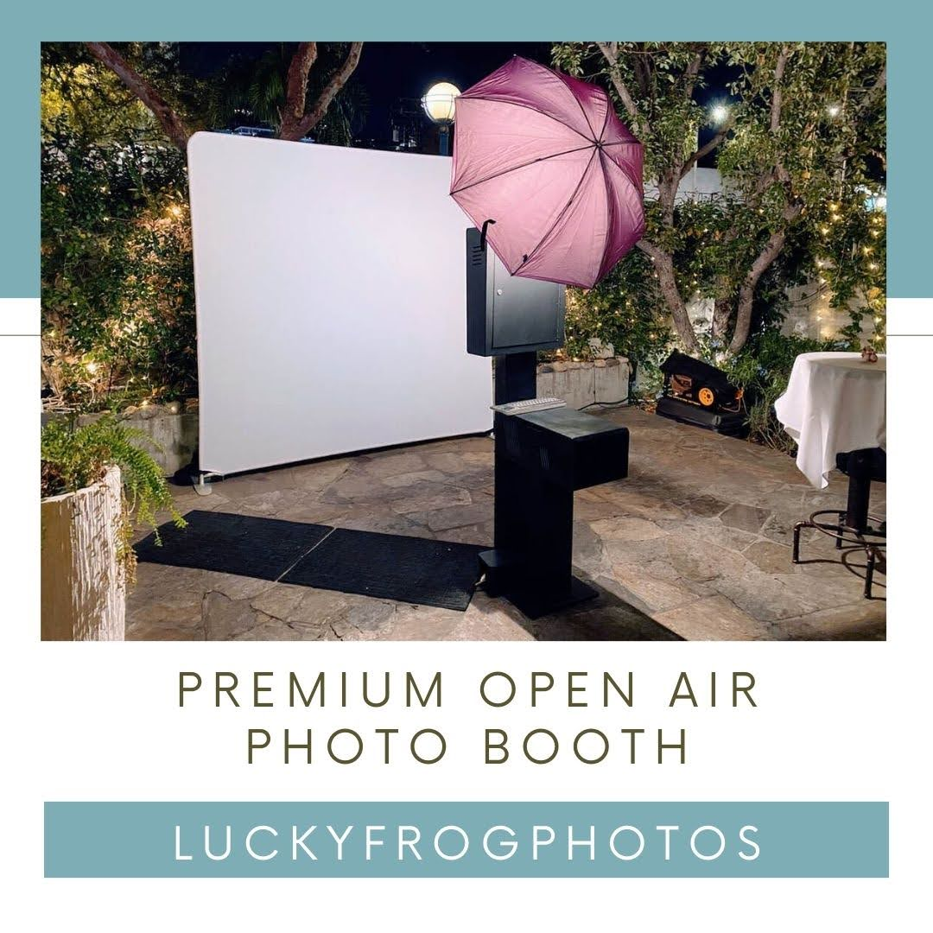

Slide 8
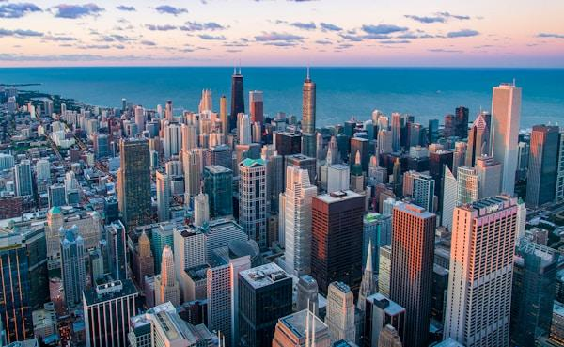

Slide 9
Links
List of recommended resources
Notes:
rent a photo booth Culver City

Slide 10
Please visit :
target url
folder top
rss feed
folder articles
folder photos
folder pdfs
folder slides
photo
photo
spreadsheet
spreadsheet key
spreadsheet pubhtml
spreadsheet pub
spreadsheet view
form
drawing
image
image link
document
document pub
document view
presentation
presentation pub
presentation view
presentation html

Slide 11
Videos
YouTube videos we recommend watching!
Notes:
rent a photo booth Culver City

Slide 12
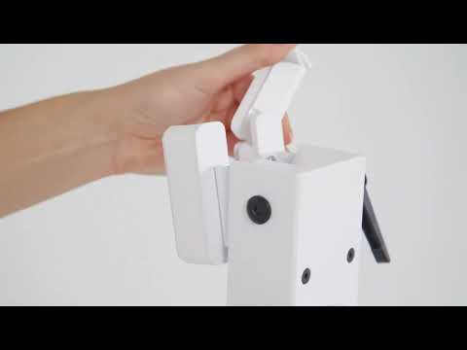
https://www.luckyfrogphotos.com/culvercityphotobooth.html

Slide 13
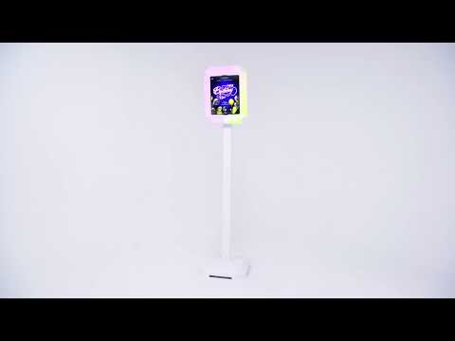
https://www.luckyfrogphotos.com/culvercityphotobooth.html

Slide 14
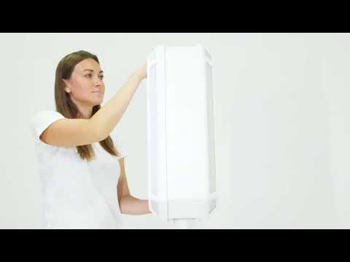
https://www.luckyfrogphotos.com/culvercityphotobooth.html

Slide 15
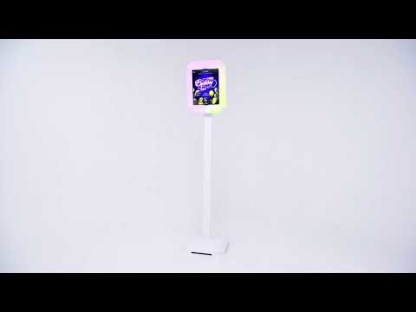
https://www.luckyfrogphotos.com/culvercityphotobooth.html

Slide 16
https://www.luckyfrogphotos.com/culvercityphotobooth.html
Notes:
https://www.luckyfrogphotos.com/culvercityphotobooth.html
https://drive.google.com/drive/folders/1loXgXNoE0I-RUbZWpLffER06fJ9YMdyE?usp=sharing
https://news.google.com/rss/search?q=videobooth
https://drive.google.com/drive/folders/1qc6tVCQqRXXF0EGfi8RbKLRrO9F6ABHu?usp=sharing
https://drive.google.com/drive/folders/1N1PP73u5W5tC4VkDr9BUmz7gKxZ71_ZR?usp=sharing
https://drive.google.com/drive/folders/19MTUo0W0-2lUwI0l-_y66wtg8IQAaqWd?usp=sharing
https://drive.google.com/drive/folders/1-FVBDkwPBknBavqmSoiC3962KZAOGOSG?usp=sharing
https://drive.google.com/file/d/1t33hvFbsi4sSFSNdR8g74m5ACVKQUi0g/view?usp=sharing
https://drive.google.com/file/d/13FEqMU8tqfWCbQquqFn89zUfZ1CBVqm-/view?usp=sharing
https://docs.google.com/spreadsheets/d/1wPWac6UXW72WiHQ3msSOrrqfTVbcssrgwqAPwNmt1mI/edit?usp=sharing
https://docs.google.com/spreadsheet/pub?key=1wPWac6UXW72WiHQ3msSOrrqfTVbcssrgwqAPwNmt1mI
https://docs.google.com/spreadsheets/d/1wPWac6UXW72WiHQ3msSOrrqfTVbcssrgwqAPwNmt1mI/pubhtml
https://docs.google.com/spreadsheets/d/1wPWac6UXW72WiHQ3msSOrrqfTVbcssrgwqAPwNmt1mI/pub
https://docs.google.com/spreadsheets/d/1wPWac6UXW72WiHQ3msSOrrqfTVbcssrgwqAPwNmt1mI/view
https://docs.google.com/forms/d/1xWsZDmztQsiIMHcFyEw45F9FKfnyUCVNaUcltDlYG1k/edit?usp=sharing
https://docs.google.com/drawings/d/1286VxJkT-XuIYFKxB1ijMVUlOr5y7QmTDpwy-RdE4FI/edit?usp=sharing
https://drive.google.com/file/d/1Ub_baxN1yIKa7z6PHbWKiQ5Hv3QmkYdb/view?usp=drivesdk
https://sites.google.com/view/culvercityphotoboothrentals/home
https://docs.google.com/document/d/1uTUEX1mh-8qPhKwXAqI2PsSf_wg8Scfp2QdfALs1d68/edit?usp=sharing
https://docs.google.com/document/d/1uTUEX1mh-8qPhKwXAqI2PsSf_wg8Scfp2QdfALs1d68/pub
https://docs.google.com/document/d/1uTUEX1mh-8qPhKwXAqI2PsSf_wg8Scfp2QdfALs1d68/view
https://docs.google.com/presentation/d/17WPDLuvcmRucLX-WnsvOM8TXcs18dp0ev9ZtfqhFATo/edit?usp=sharing
https://docs.google.com/presentation/d/17WPDLuvcmRucLX-WnsvOM8TXcs18dp0ev9ZtfqhFATo/pub?start=true&loop=true&delayms=3000
https://docs.google.com/presentation/d/17WPDLuvcmRucLX-WnsvOM8TXcs18dp0ev9ZtfqhFATo/view
https://docs.google.com/presentation/d/17WPDLuvcmRucLX-WnsvOM8TXcs18dp0ev9ZtfqhFATo/htmlpresent

Slide 17
rent a photo booth Culver City
https://www.luckyfrogphotos.com/culvercityphotobooth.html
Notes:
rent a photo booth Culver City

